Slide 1
Automated API integration tests benefits
Running integration tests automatically (usually by CI jobs or VCS hooks)
Help to automate annoying/complex error-prone or time-consuming steps (e.g. authentication, checks of JSON fields)
Make test results repeatable (written once, should work everywhere)
Make test results consistent and accurate, avoiding human-introduced mistakes
manual test cycles can lead to mistakes, whereas automated testing achieves accurate results every time
Environment type agnostic tests (CI / DEV / QA - it depends only on configuration)
Produce exhaustive test results suitable for further analysis
Reduce time of regression testing (eventually reduce costs of a project after all)
Reduce an amount of manual testing (or sometimes even excludes it)
Help to raise the flag automatically when something has broken after the changes in a codebase
Help DevOps team to test deployed application/API/service without any help
Help to test API even without a client application (native iOS application in case of CDX)
Features delivery with more confidence
Mimic the behavior of a client application and explains the workflows used to interact with API

Slide 2
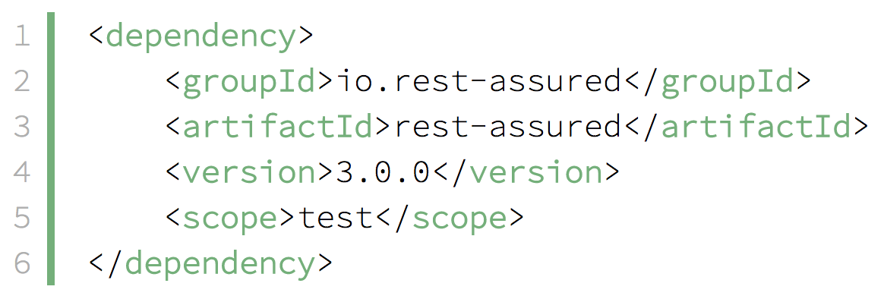
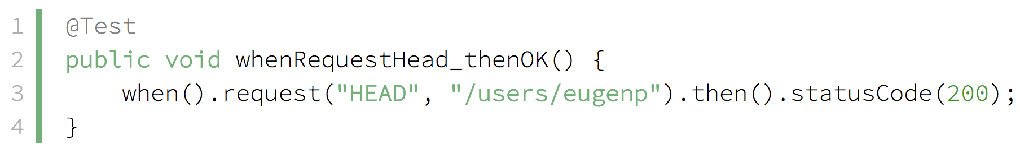
Rest Assured library benefits
Ideal for our simple integration tests
Already used in UBS
Lightweight library
Simple and fast to catch
Supports given/when/then notation
Supports POJOs & JSON
Supports JsonPath-notation
Popular solution, supported, well-known to community
Less boilerplate code
Could be used on every machine that has only a build tool installed (maven / gradle / ant)

